Slide 1
SBA To Provide Economic Injury Disaster Loans
For Coronavirus Related Economic Disruptions

Slide 2
SBA’s Economic Injury Disaster Loan Basics
What businesses are eligible to apply?
SBA’s Economic Injury Disaster Loans (or working capital loans) are available to small businesses, small agricultural cooperatives, small aquaculture businesses and most private non-profit organizations
This includes:
Businesses directly affected by the disaster
Businesses that offer services directly related to the businesses in the declaration
Other businesses indirectly related the industry that are likely to be harmed by losses in their community
(Example: Manufacturer of widgets may be eligible as well as the wholesaler and retailer of the product.
2

Slide 3
SBA’s Economic Injury Disaster Loan Basics
What is the criteria for a loan approval?
Credit History-Applicants must have a credit history acceptable to SBA. Repayment –SBA must determine that the applicant business has the ability to repay the SBA loan.
Eligibility- The applicant business must be physically located in a declared county and suffered working capital losses due to the declared disaster, not due to a downturn in the economy or other reasons.

Slide 4
SBA’s Economic Injury Disaster Loan Terms
How much can I borrow?
Eligible entities may qualify for loans up to $2 million.
The interest rates for this disaster are 3.75 percent for small businesses and 2.75 percent for nonprofit organizations with terms up to 30 years.
Eligibility for these working capital loans are based on the size (must be a small business) and type of business and its financial resources.
How can I use the loan funds?
These working capital loans may be used to pay fixed debts, payroll, accounts payable, and other bills that could have been paid had the disaster not occurred. The loans are not intended to replace lost sales or profits or for expansion.

Slide 5
Economic Injury Disaster Loan Terms
What are the collateral requirements?
Economic Injury Disaster Loans over $25,000 require collateral.
SBA takes real estate as collateral when it is available.
SBA will not decline a loan for lack of collateral, but requires borrowers to pledge what is available.
5

Slide 6
SBA’s Working Capital Loans are Different from Other SBA Loans
SBA’s Economic Injury Disaster Loan (EIDLs) funds come directly from the U.S. Treasury.
Applicants do not go through a bank to apply. Instead apply directly to SBA’s Disaster Assistance Program at: DisasterLoan.sba.gov
There is no cost to apply.
There is no obligation to take the loan if offered.
The maximum unsecured loan amount is $25,000.
Applicants can have an existing SBA Disaster Loan and still qualify for an EIDL for this disaster, but the loans cannot be consolidated.

Slide 7
Ineligible Entities
What are some of the businesses that are ineligible for an Economic Injury Disaster Loan?
Agricultural Enterprises -If the primary activity of the business (including its affiliates) is as defined in Section 18(b)(1) of the Small Business Act, neither the business nor its affiliates are eligible for EIDL assistance.
Religious Organizations
Charitable Organizations
Gambling Concerns (Ex: Concerns that derive more that 1/3 of their annual gross revenue from legal gambling activities)
Casinos & Racetracks (Ex: Businesses whose purpose for being is gambling (e.g., casinos, racetracks, poker parlors, etc.) are not eligible for EIDL assistance regardless of 1/3 criteria above.
7

Slide 8
How to Apply
SBA’s Customer Service Representatives are ready to serve.
Applicants may apply online using the Electronic Loan Application (ELA) via SBA’s secure website at https://disasterloan.sba.gov/ela.
Paper loan applications can be downloaded from www.sba.gov/disaster. Completed applications should be mailed to: U.S. Small Business Administration, Processing and Disbursement Center, 14925 Kingsport Road, Fort Worth, TX 76155.
Disaster loan information and application forms may also be obtained by calling the SBA’s Customer Service Center at 800-659-2955 (800-877-8339 for the deaf and hard-of-hearing) or by sending an email to disastercustomerservice@sba.gov.

Slide 9
Submit Your Application As Soon As Possible
Recheck the filing requirements to ensure that all the needed information is submitted.
The biggest reason for delays in processing is due to missing information. Make sure to complete all filing requirements before submitting the application and forms.
If more funds are needed, applicants can submit supporting documents and a request for an increase. If less funds are needed, applicants can request a reduction in the loan amount.
If the loan request is denied, the applicant will be given up to six months in which to provide new information and submit a written request for reconsideration.

Slide 10
Disaster Loan Application Portal (DLAP)
DOUBLE-CLICK ON THE LINK TO ACCESS THE SITE
https://disasterloan.sba.gov/ela/
DOUBLE-CLICK APPLY ONLINE
Notes:
Once you click on the link, the Disaster Loan Assistance page will populate, you can click on Apply Online in the right hand corner or you can click on the circle in the middle of the page, either one of these links will take you to the registration page.

Slide 11
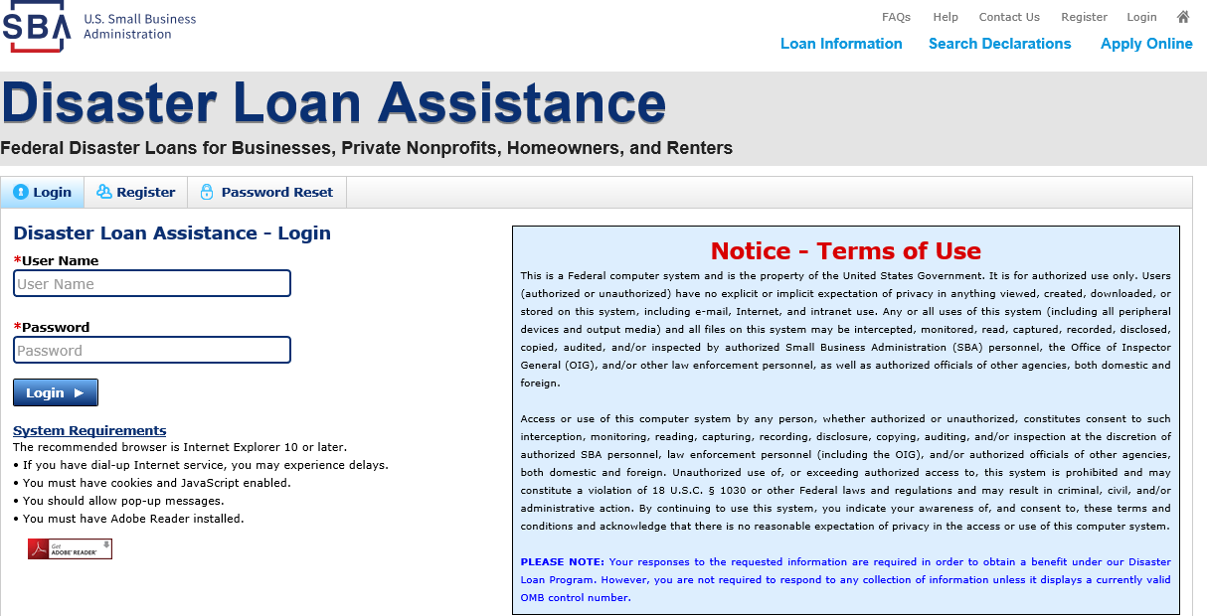
Register
From this page you can:
1) Begin a new application by clicking on Register
2) Return to complete a started application by inputting a user name and password
Notes:
From this page you can register as a new user or if you have started an application you can re-enter DLAP to complete the application process. In this example we will begin the registration process.

Slide 12
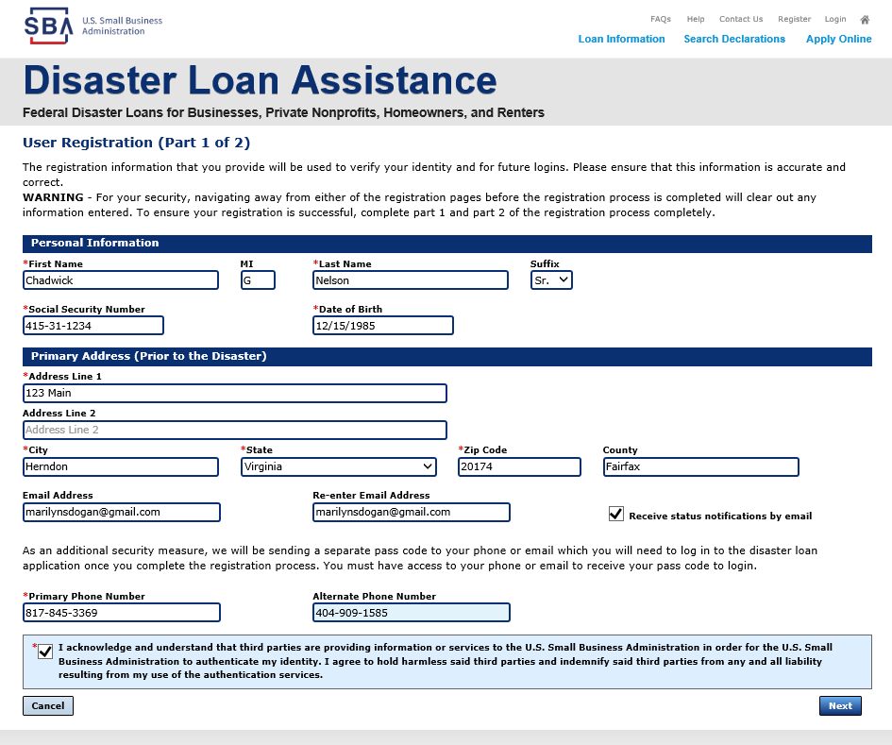
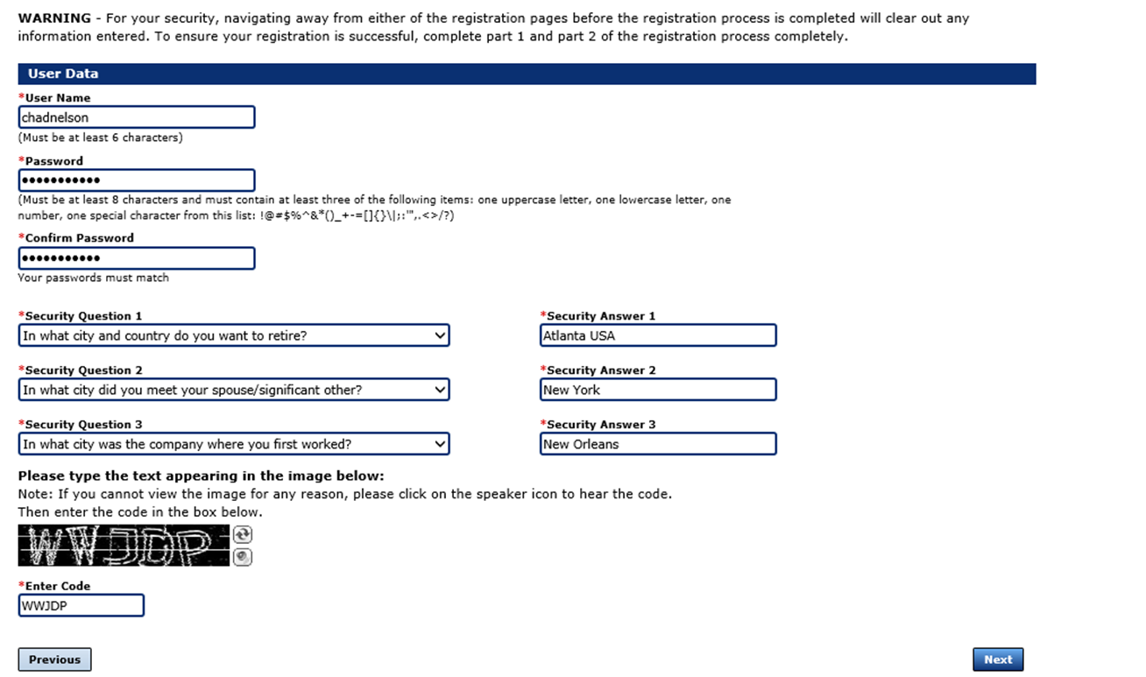
Complete Registration Information
On page 1 of the registration, pay close attention to the sections with an * these sections must be completed. It is important that a good email address and cell phone number are supplied.
On page 2 of the registration you will create your unique user-name and password. When creating your security questions, make sure to use information you won’t likely forget. If your password ever requires a reset, you would need this information
To advance to the next page, go next
Notes:
This page is easy to understand and complete, just make sure you are completing every section that has an *. Once you complete page one, click on the NEXT tab. You will go to page two where you will set up your username and password. This information has to be unique to each individual. It is important that you select security questions that will be easy for you to remember. Once you complete your registration, you will be able to begin submission of your application.

Slide 13
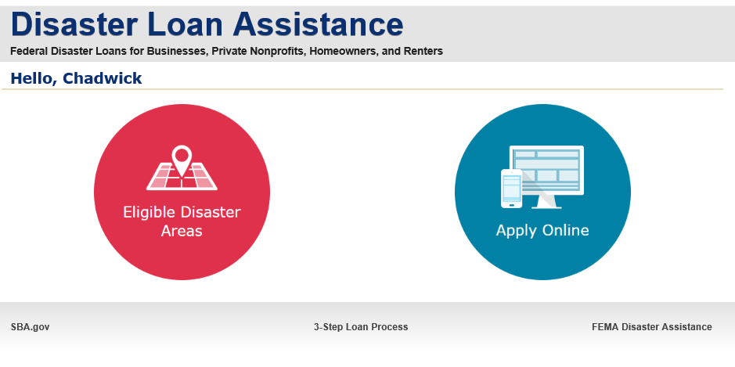
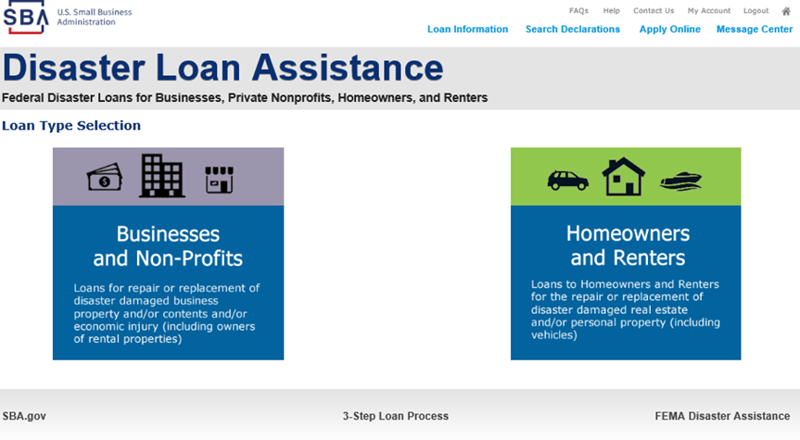
Apply Online
Double Click on “Apply Online”
Double Click on Business and Non Profit
Notes:
Click the circle that says “Apply Online” then click on the Business and Non-Profit icon.

Slide 14
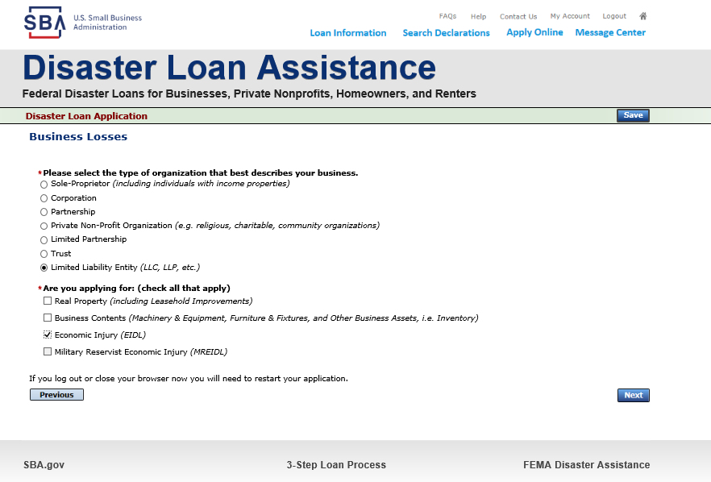
Business Type
SBA Form 5 would be completed by:
Corporations
Partnership
Private Non-Profit Organizations
Limited Partnership
Trust
Limited Liability Entity
SBA Form 5C would be completed by:
Sole Proprietorship
Once you make your selection the system will automatically direct you to the form.
Notes:
In this example, the business type is a LLC, this business type would complete Form 5.

Slide 15
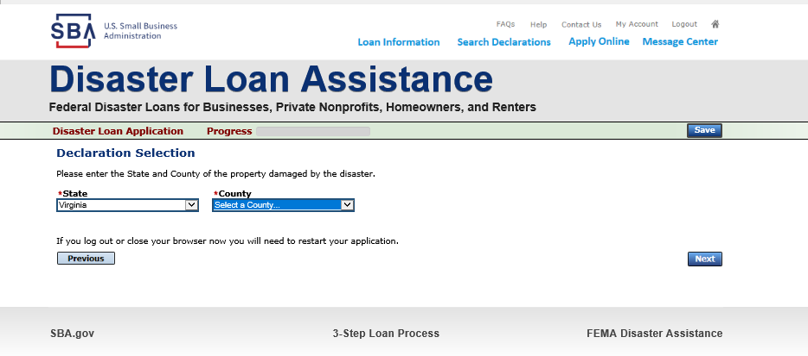
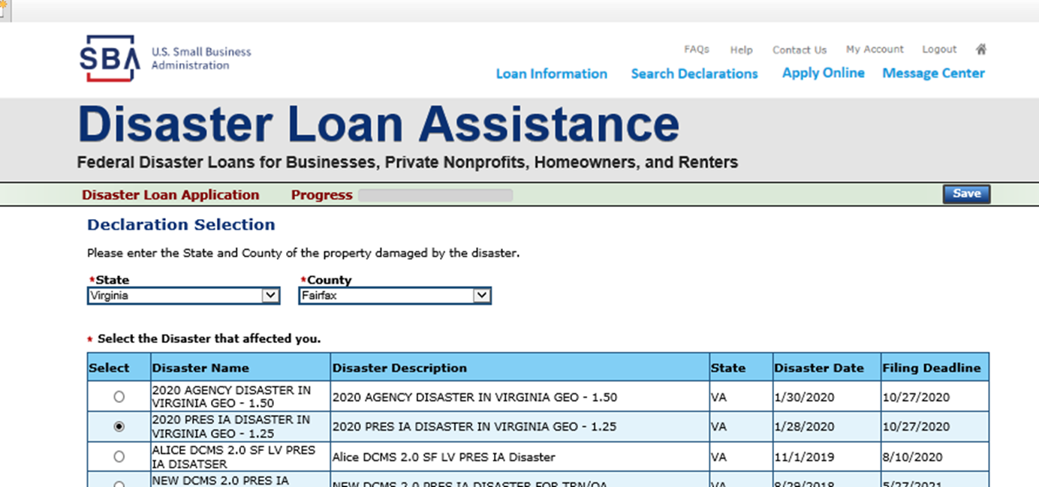
Select State /County / Disaster Declaration
Use the drop-down box and select the State and County where the loss has happened
Select the disaster declaration
Notes:
Next you will use the dropdown box and select your State and County, then depress the next button in the right hand corner. From the next page you would select your declaration – make sure the declaration indicated EIDL>

Slide 16
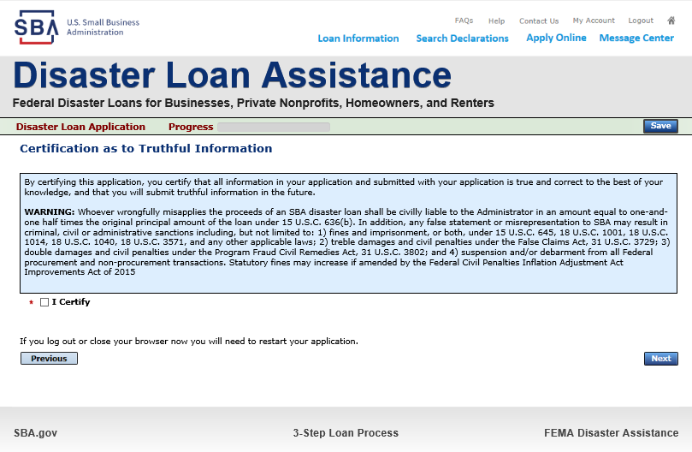
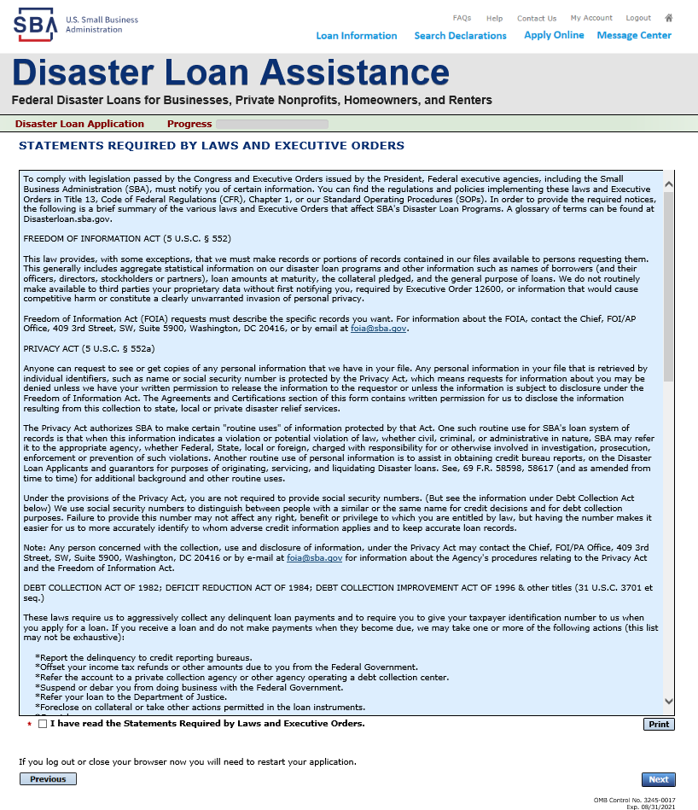
Complete Certifications
Read and Electronically Agree to the Certification of Truthful Information and the Executive Orders Document.
Notes:
You must complete the 2 disclosures, the first is Certification of Truthful Information and the other provides information about Executive Orders such as Freedom of Information Act, Privacy Act, Debt Collection Act, Right to Financial Privacy Act, Coastal Barrier Resources Act, Tx Homestead Law

Slide 17
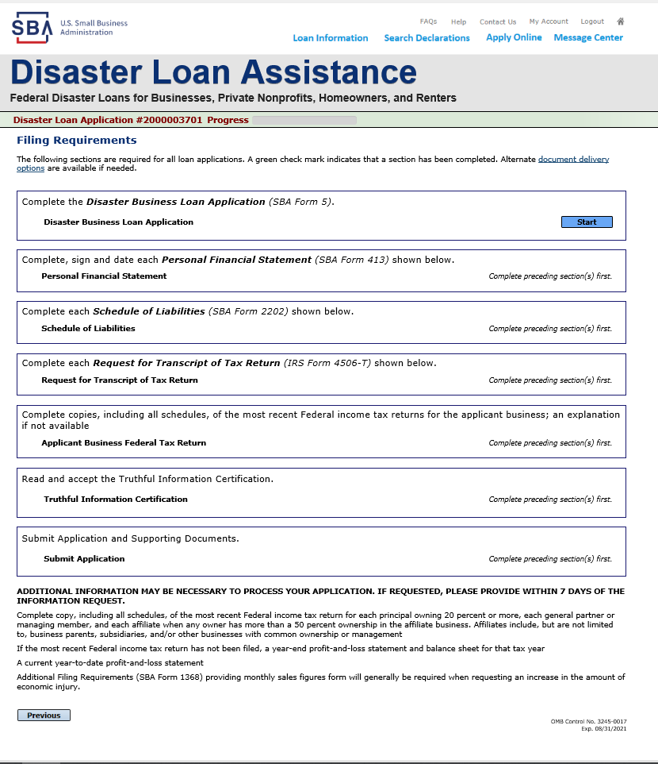
Start Application – Form 5
This business type for this example is an LLC.
This page provides information on all the filing requirements necessary to have a successfully completed application.
To begin depress START
Notes:
Now we are about to start the Disaster Loan Application Form 5 by depressing the “Start” Button.

Slide 18
Form 5 – Page 1
Fill in the information on this page as necessary, items with a red * are mandatory field and you will not be able to advance to NEXT until these sections are completed.
Notes:
There are 3 pages to the actual application. Information from the registration will automatically complete portions page one, i.e., what an individual is applying for and the organization type. All sections with an * must be completed.

Slide 19
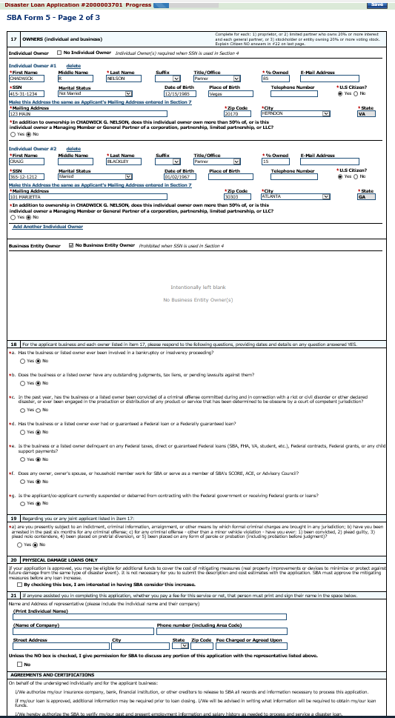
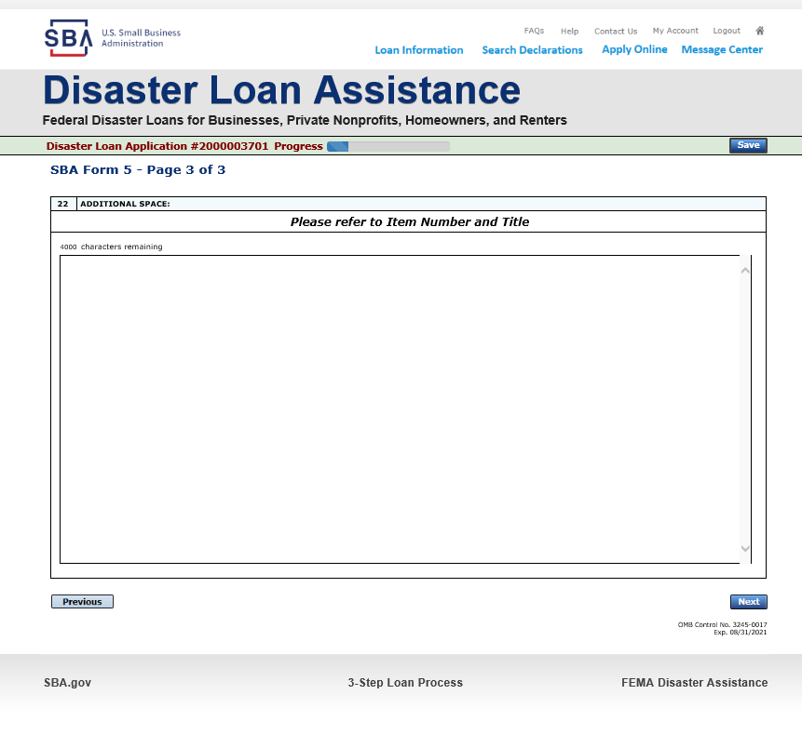
Form 5 – Pages 2 and 3
Page 3 is used for any relevant comments
Page 2 of Form 5 allows the business owner to provide information about any Partners or Affiliate Businesses.
Note: If a business is a partnership all members must listed with the % of ownership until the combined entries equal 100%
Notes:
On page 2, additional information can be input about the number of owners and their % of ownership is input on this page or whether the ownership is another business entity. Affiliate information will be captured on this page as well. It is important to note that the individual applying needs to supply information on all business interest whether that business in a declared area or not.

Slide 20
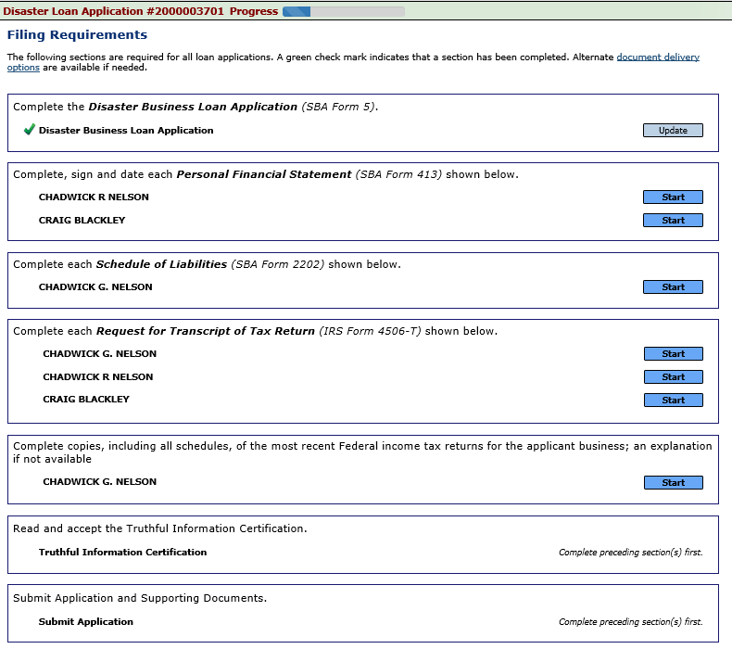
Filing Requirements
Now that the application is complete, the filing requirements on this page must be submitted / uploaded to complete the process.
Notes:
Once the application is completed, the filing requirements must be uploaded. Every business owner that has more than 20% interest will be required to submit a Personal Financial Statement (SBA Form 413) and their individual tax transcripts completing form 4506T.

Slide 21
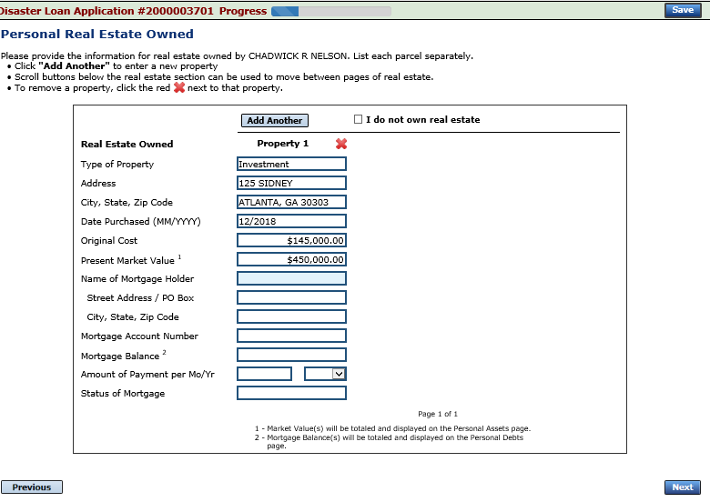
Personal Financial Statement
You can use this form to complete your personal financial statement or upload a financial statement you already have by scanning and uploading that document
If you indicated you have real estate you must complete this form, supplying additional information
Notes:
Once you click on the financial statement you can complete this form.

Slide 22
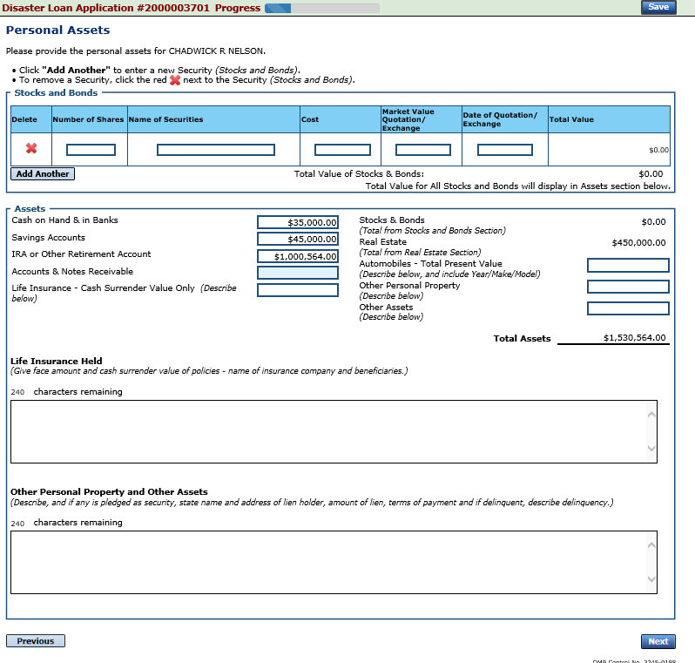
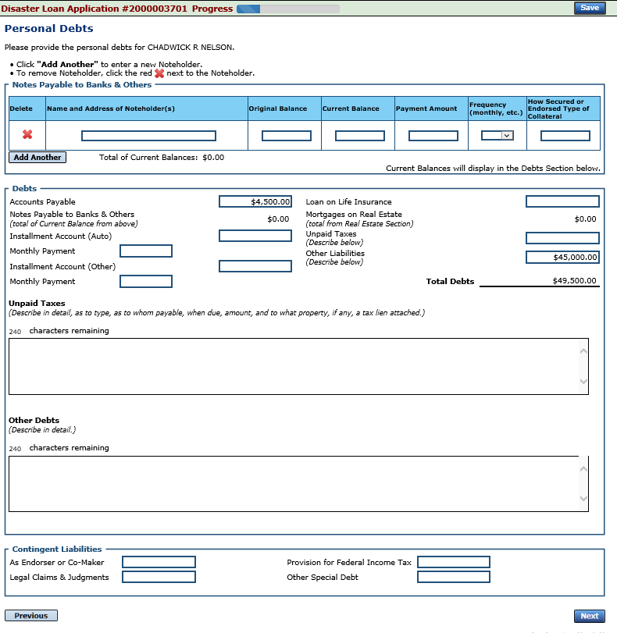
Personal Assets / Debits
The applicant and any partner would need to provide information on assets and debits
Notes:
You will complete information related to personal assets and debts. The loan officer will use this information in determining whether you qualify or not.

Slide 23
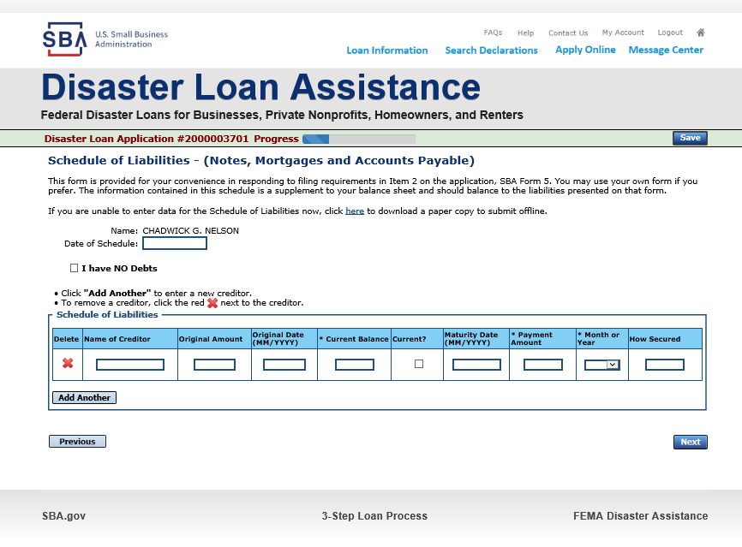
Schedule of Liabilities – SBA form 2202
Applicant would click on Schedule of Liabilities and either complete the SBA form or upload the applicant’s document
Notes:
Again you will depress the start button to complete the schedule of liabilities, if however you are like Dave Ramsey and are debt free, check the box that says “I have No Debts”, the system will generate a confirmation that says are you sure you want to delete this page, you would simply confirm

Slide 24
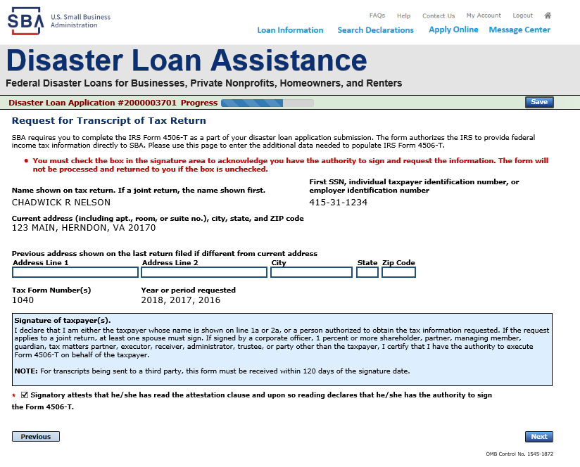
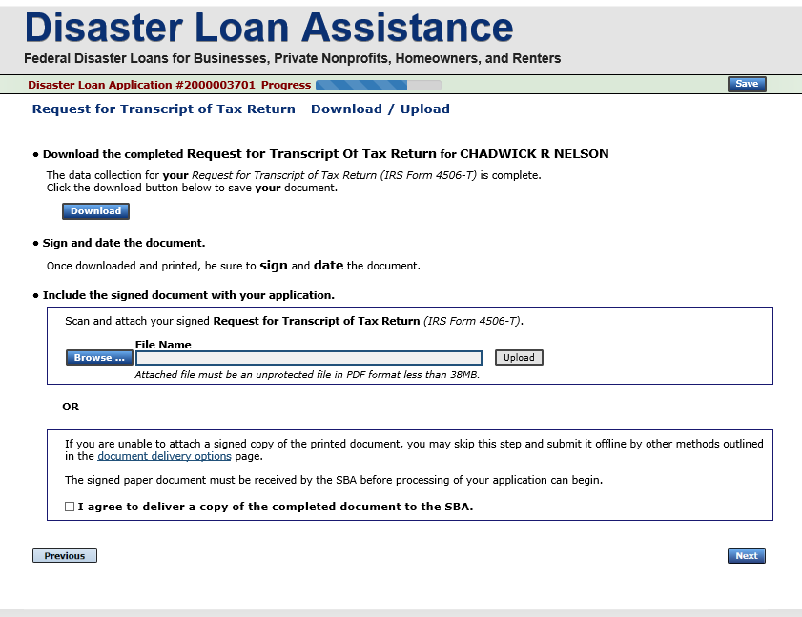
Uploaded 4506T
The 4506T can be uploaded once the form is printed and signed. You would need to save a copy on your desktop, once saved browse find the document and upload.
You could also opt to deliver offline
Notes:
You must check the box giving SBA authorization to pull your tax transcripts, once you check this box, you would depress next. You would 1st download the form, sign it and scan it to your desktop naming it Nelson 4506T, next you would go to browse and find the document then depress upload. If you are required to submit a 4506T for a Partner and perhaps they aren’t’ available, you could check the box that says I agree to deliver a copy of the completed document offline. This would mean this document would need to be sent to the PDC once completed. If this option is selected you would receive information with the address.

Slide 25
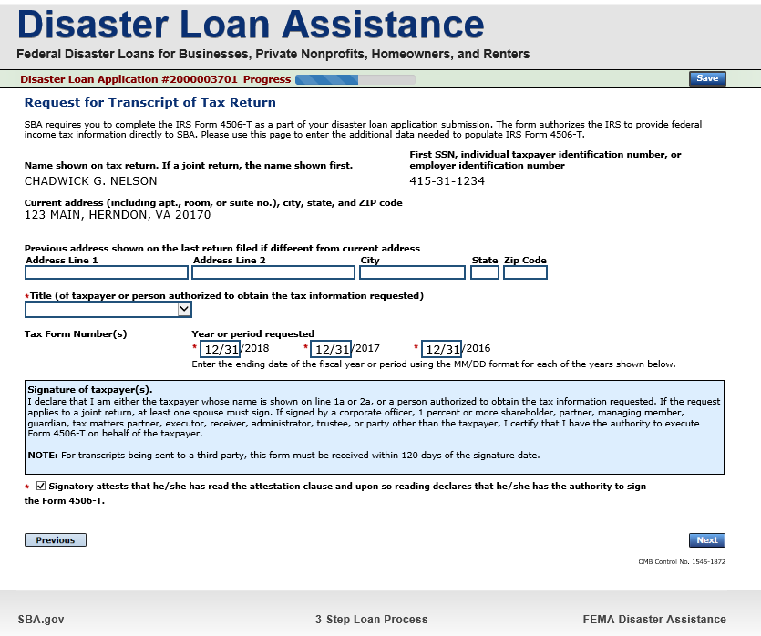
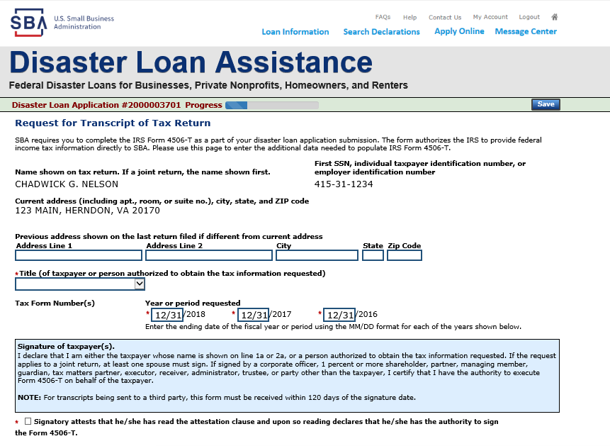
Electronically file 4506T
Each Applicant and Partner must submit a 4506T
Notes:
Tax transcripts will be requested for the business and the individual.

Slide 26
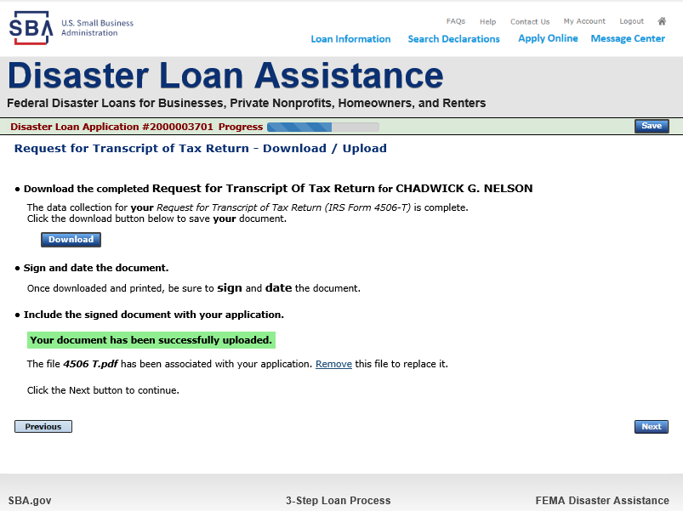
4506T Uploaded Successful
Once the 4506 T is uploaded you will receive a message back indicating the transmittal was successful. Make sure all fields are complete. All partners must submit this form for their individual and business taxes.

Slide 27
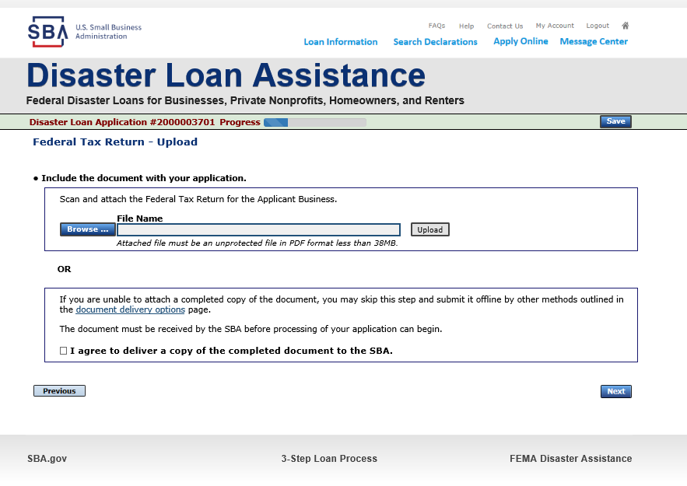
Tax Returns
To complete your application you must upload your most recent tax returns.
Taxes would be scanned and saved on the desktop. You would browse your desktop and then upload the tax returns.
Notes:
Once all request for tax transcripts has been uploaded, the system will take you to the Certificate as to Truthful Information

Slide 28
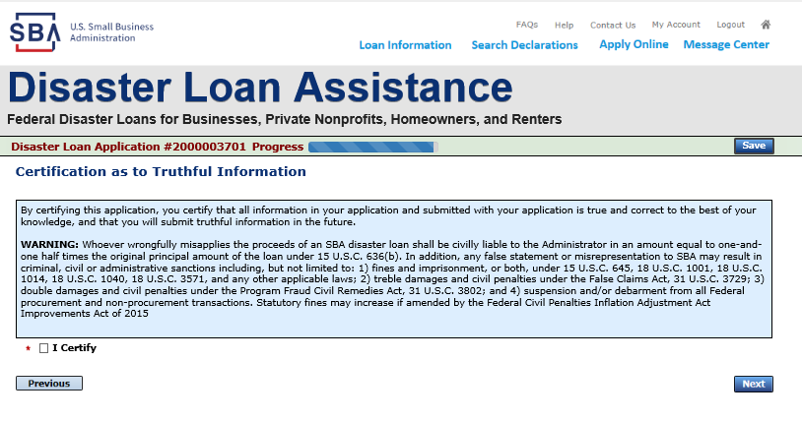
Certificate as to Truthful Information

Slide 29
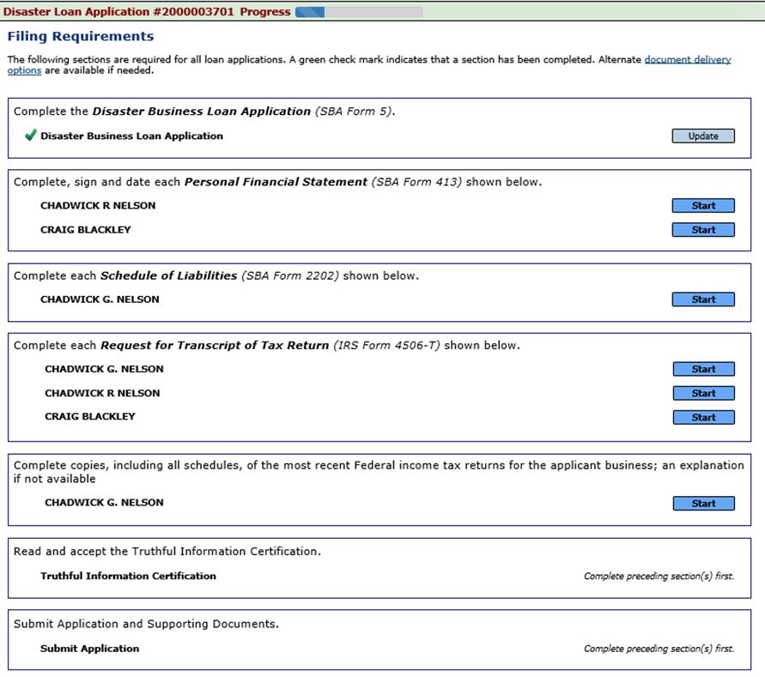
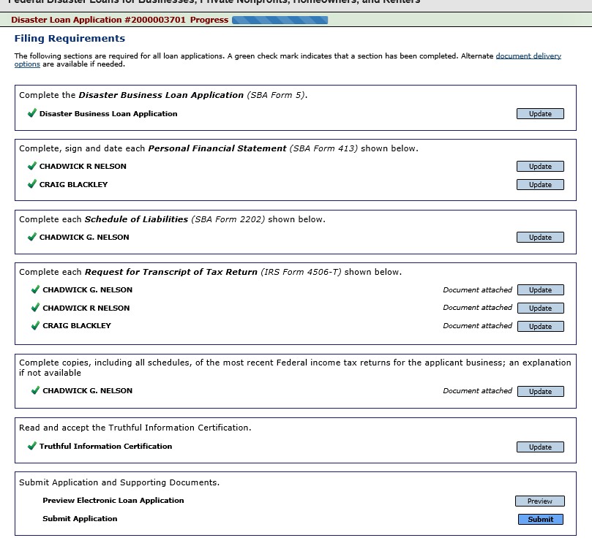
Filing Requirements Complete
You can see that all filing requirements no longer say “start” what shows now is all filing requirements have been updated and the application is ready to submit
Notes:
At the beginning of the process all the filing requirements were in blue and said “Start”. Once you upload the information, these tabs turn a lighter blue and the tab changes to update, until you depress the submit you can go back and update any of the filing requirements. If you are sure you are done you would simply depress submit.

Slide 30
Application Successfully Submitted
Once the application is successfully submitted you will get this page. In the right hand corner a message indicator will appear. The message confirms submittal of the application
Notes:
Once the application is successfully submitted you will receive a confirmation indicating your disaster loan application has been submitted. As the application goes through the various stages, you will receive emails and messages in the loan application portal.

Slide 31
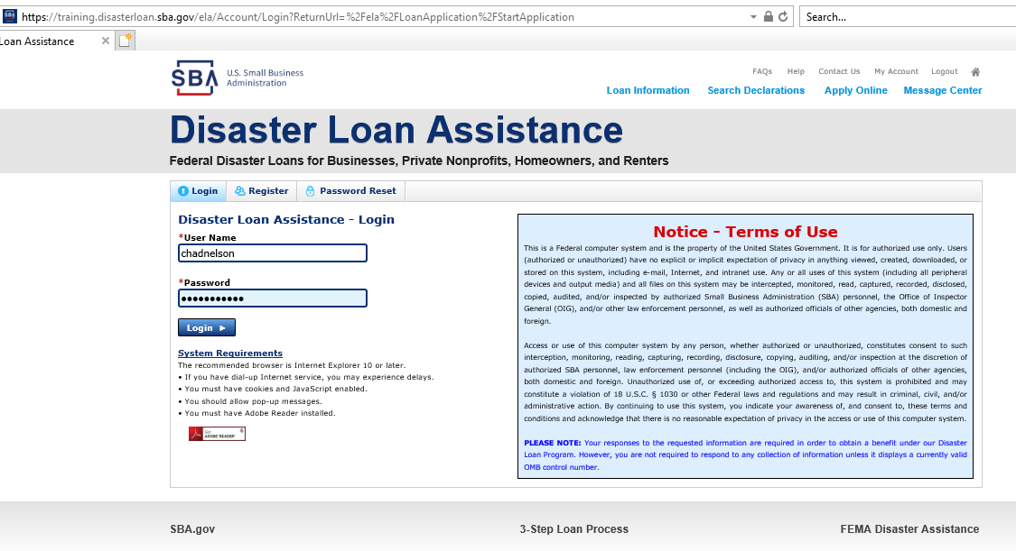
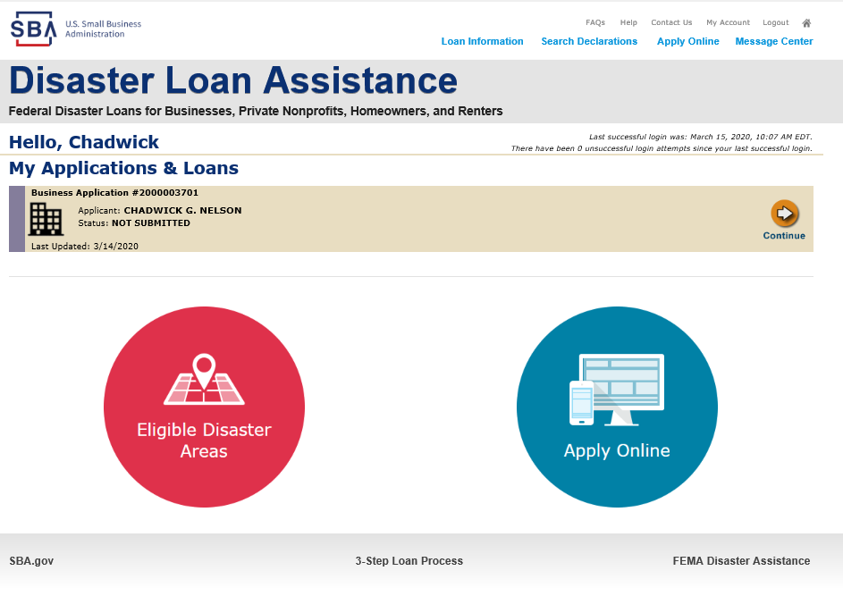
Returning to Complete Application
Input your user-name and password to complete a started application, once in click on “Continue”
Notes:
If you started and application and needed to return and complete it, you would go to the register page and input your username and password, then depress login, from the next page you would depress continue. As you can see from this example the status of this file is “NOT SUBMITTED

Slide 32
Business Losses
A Sole-Proprietor will use “Sole-Proprietor” and “Economic Injury (EIDL).
Notes:
Now we will look at a Sole Proprietorship Business, applying for an EIDL loan.

Slide 33
Home/Personal Losses
The Loan Application will walk you though the process. Click “Save” to save the input and click “Next” to navigate to the next page.
Notes:
Some Sole Props are done out of an individual’s home, you would check what is appropriate

Slide 34
Declaration Selection
On the same line as the “Save” icon you also can see the “Progress” of the Disaster Loan Application.
Enter your “State” and “County”
Notes:
Select the disaster

Slide 35
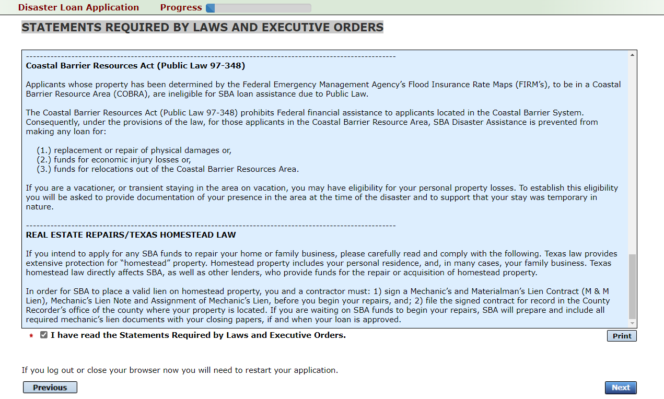
Certification and Executive Order
Read the “Warning”, check “I Certify” then click “Next”.
Read the information, check “I have read…” then click “Next”.
Notes:
Again you would sign off on the 2 disclosures, Certification of Truthfulness and the various Executive Orders

Slide 36
Filing Requirements
To continue with the application process click “Start” to complete SBA Form 5C.
Notes:
Because this is a sole prop, you would be completing SBA Form 5C

Slide 37
Completing Form 5C - Sole Proprietor Loan Application
Fill in the information blocks and then hit next. Fields marked with a red asterisk is a required field.
Notes:
This page looks a little different than Form 5, it is important that all the fields with the red asterisks are completed. Please note it has been indicated this individual also has interest in another business.

Slide 38
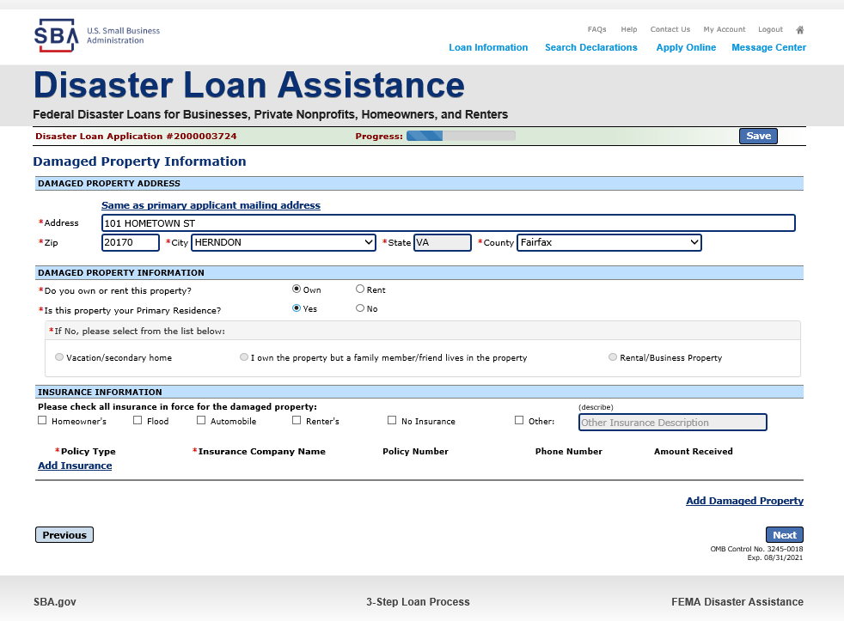
Form 5C continued - Damaged Property Information
Fill in the information blocks and then hit next. Fields marked with a red asterisk is a required field.
Notes:
If the damaged property is the same as the mailing address you can double click on the “Same as Primary applicant mailing address” and this will auto populate

Slide 39
Form 5C continued -Debts and Assets Information
Fill in the information blocks and then hit next. Fields marked with a red asterisk is a required field.
Notes:
This page will require your debts and assets

Slide 40
Form 5C continued - Disclosure Statements
Fill in the information as required and then hit next.
Fields marked with a red asterisk is a required field.
Notes:
Disclosure statements same as the business application

Slide 41
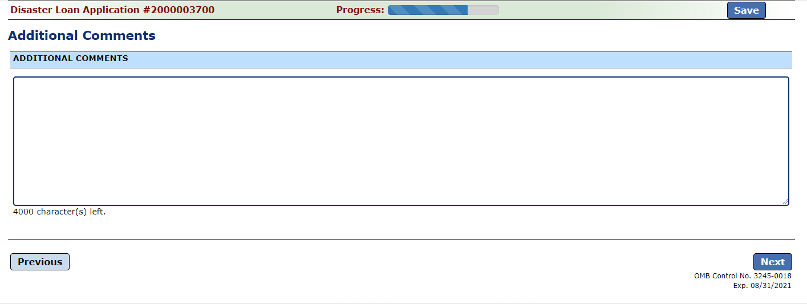
Form 5C continued - Consent and Additional Comments
Read the information, check “All the information…” then click “Next”.
Additional Comments are used for clarifying or additional information.
Click “Next” to continue the process.

Slide 42
Form 5C continued - Affiliated Businesses
Fill out the Affiliated Business information then click “Save”.
To continue the process click “Next”.
Notes:
You would input the information about the affiliate business you indicated on the first page.

Slide 43
Completing IRS Form 4506-T
Once you have finished the SBA Form 5C, the tax transcript information will need to be completed.

Slide 44
Request for Transcript of Tax Return
Form 4506T can be submitted electronically, via upload or offline. If the eSign option populates click through the options until the document is successfully completed. If you upload the document you would save it on your desktop, select browse and then upload.

Slide 45
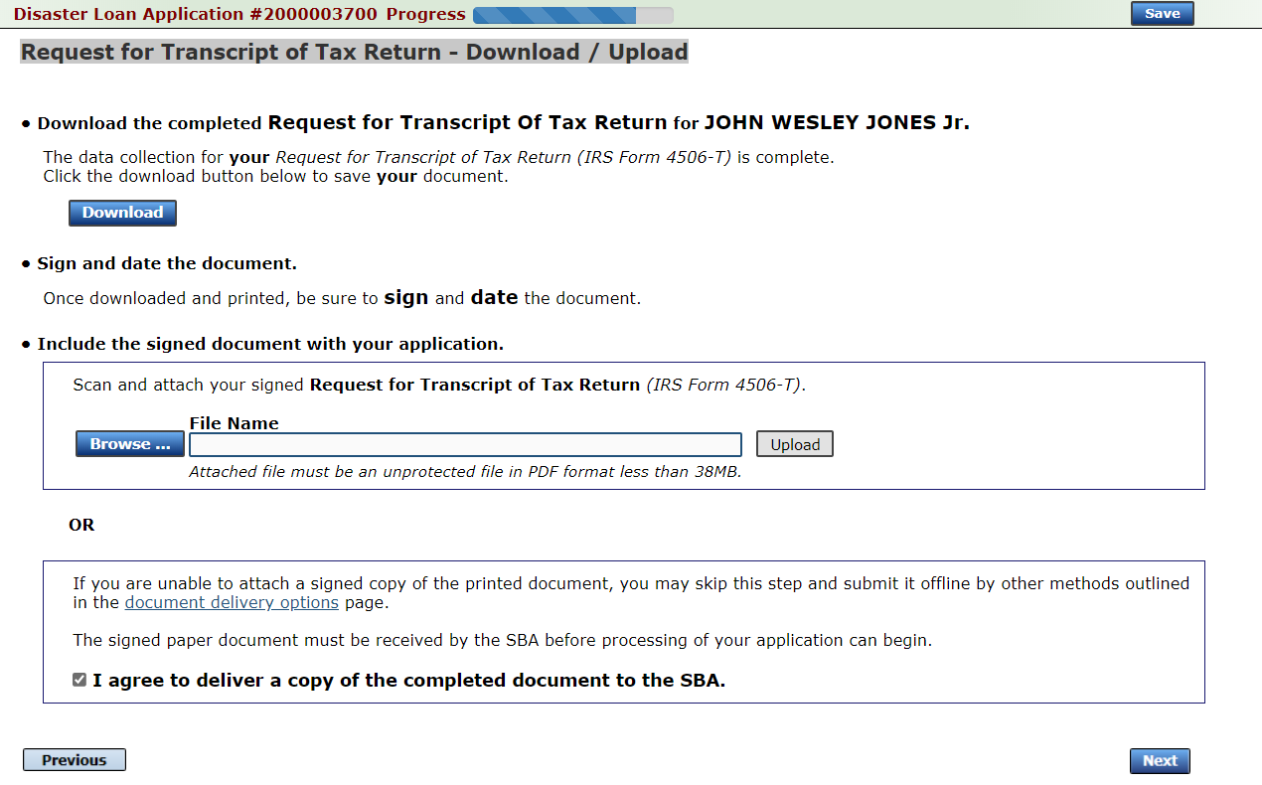
Request for Transcript of Tax Return - Download / Upload
If you chose to deliver a copy this alert will appear. And you will no longer be able to upload information. The document will have to be submitted offline.

Slide 46
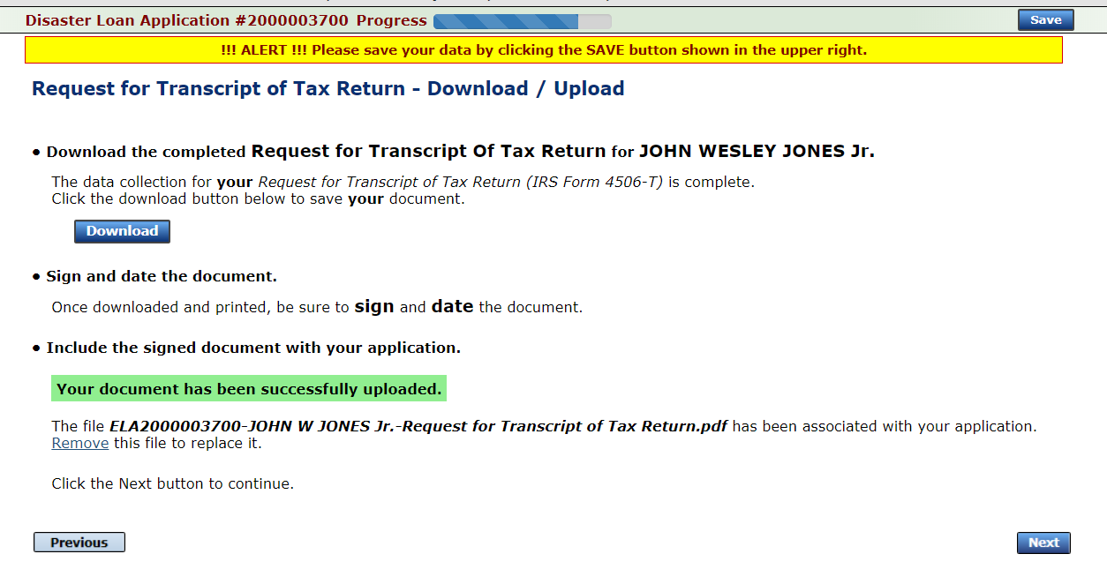
Request for Transcript of Tax Return - Download / Upload
Successfully Uploaded will appear when finished.
Then click “Next” to continue the process.
Once you have downloaded your tax returns you can upload.

Slide 47
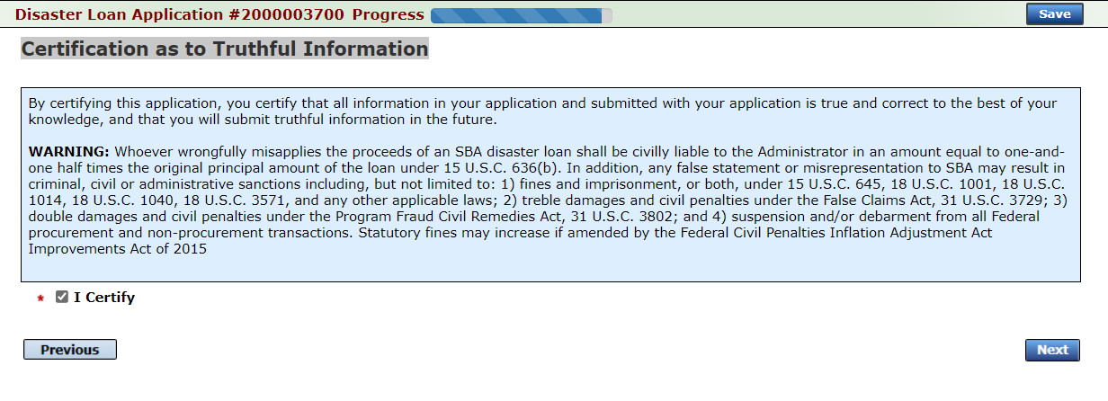
Filing Requirements
Once the tax returns are complete sign the final Truthful Information Statement.
Notes:
You can update up until you depress submit after that it’s too late.

Slide 48
Submit Application
Finally you can submit your application when the “Submit” icon appears.

Slide 49
Application Submission Confirmation
After submission you will see that your application number has been submitted.
Notes:
Message center validates submission

Slide 50
Message Center

Slide 51
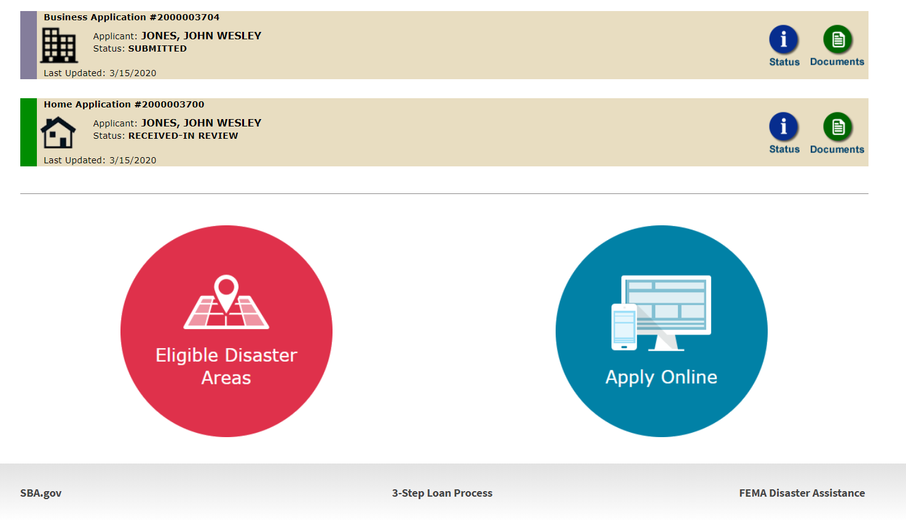
Home Page
After competing application you automatically return to the home page.
From here you can check the status of your application by clicking the “Status” icon.

Slide 52
Application Status

Slide 53
Special Note
If you receive a message like the one below, depress “SAVE” so that you don’t lose your information.
Notes:
On the top ribbon you will receive a warning sign if you are taking to long. Depress Save when you see this message to insure you don’t lose your information.

Slide 54
Example of Sole Proprietorship Business /What is needed?
Types of Sole Proprietorship Businesses:
Rental Property
Home base businesses
Self employed trades
IT Consultation Services
Tutoring
Catering Service
Music Instructor from the home
What is needed
Completed Loan Application 5C
All Filing Requirements Submitted
Statement of Loss
Monthly Sales
Submit SBA Form 1368
An excel worksheet with this information
A report from quick books
Decision: From the time a completed application is received it can take up to 21 days for a decision to be made.

Slide 57
U.S. Small Business Administration Emphasis on Sole Proprietor Business

